Slide 1
ODK: Creating and Testing a Survey in App-Designer
Dr. Caroline Krafft
St. Catherine University
cgkrafft@stkate.edu
Version: January 19, 2018

Slide 2
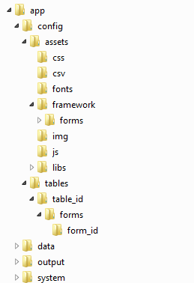
Directory Structure
App-designer on your computer (and correspondingly the files on tablets and the server) have a very particular directory structure
This structure is critical for the program “finding” things correctly
Within app-designer there are forms and tables (these generally correspond to a survey)
There are also assets, like lists of preloaded data

Slide 3
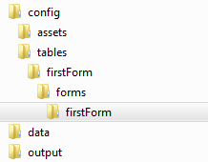
The app-designer/app/config/tables Folder
When you create a survey you need to give it a name and use that as the table_id and form_id
These are two key structures of the survey
Advanced note: Multiple form_id can write to one table_id, which is why forms are nested within tables
Need to add a structure of:
app-designer/app/config/tables/table_id/forms/form_id
Construct this example structure: app-designer/app/config/tables/firstForm/forms/firstForm
Case sensitive!!!
Notes:
Note: throughout slides blue is where you type, red is what you type, green is what you (should) see

Slide 4
Making your first form
We make our forms in Excel (*.xlsx)
Forms require 3 tabs:
survey: The questions (or sections)
settings: Names the files, gives languages, etc.
choices: Response options for select-one of select-multiple questions
Make an Excel form with these three tabs and save with name firstForm.xlsx in app-designer/app/config/tables/firstForm/forms/firstForm
Note: if you are not starting with a blank app designer, we suggest making a copy and then emptying out the tables folder

Slide 5
Settings Sheet
Column headers:
Required: (A) setting_name, (B) value, (C) display.title.text
setting_name has defined options, like form_id
value is something you provide, like the name of the form_id (firstForm)
display.title.text changes the title shown (for example, “First Survey Form”)
Create rows for form_id, form_version, table_id, and survey in the setting_name column. Fill in:
form_id and table_id rows, value column: firstForm
form_version row, value column: 20180101
survey row, display.title.text column: First Survey Form

Slide 6
Survey sheet
This is where you ask questions
Column headers: (A) type, (B) values_list, (C) name, (D) display.prompt.text
type is the kind of question
values_list is the name of the list of choices for a multiple choice question
name will be the variable name in the resulting data
display.prompt.text is the question to display on the tablet
Let’s do our first question! Fill out a row with:
type: select_one
vaues_list: yesno
name: test
display.prompt.text: Did this test work?

Slide 7
Choices sheet
This is where you put response options for some kinds of questions
Column headers: (A) choice_list_name, (B), data_value, (C) display.title.text
choice_list_name puts together related responses in a list
data_value is how the data will be outputted
First row:
choice_list_name: yesno, data_value: =“1”, display.title.text: Yes
Second row:
choice_list_name: yesno, data_value: =“2”, display.title.text: No
At least in the current version, ODK does not handle data_values that are formatted as numbers well
Have to do =“#” for data to “stick”

Slide 8
You made your first form!
…But now we have to move it from Excel into all the other apps
…Which requires making a second form, the framework

Slide 9
Framework
The framework.xlsx is central to the structure of app-designer
It says what surveys (forms) exist
It’s structured just like a form
Open a blank Excel and save it to the config/assets/framework/forms folder with the name framework.xlsx
Note: if you are not starting with a blank app designer, we suggest making a copy and then emptying out the tables folder

Slide 10
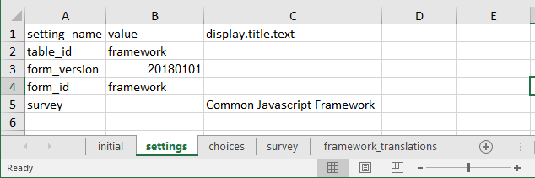
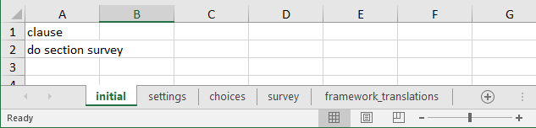
Creating the Framework
Make the initial tab
In initial you need a column header clause
Clause: do section survey
Make the settings tab with the usual column headers (A) setting_name, (B) value, (C) display.title.text
table_id & form_id value: framework
form_version value: 20180101
display.title.text survey : Common Javascript Framework

Slide 11
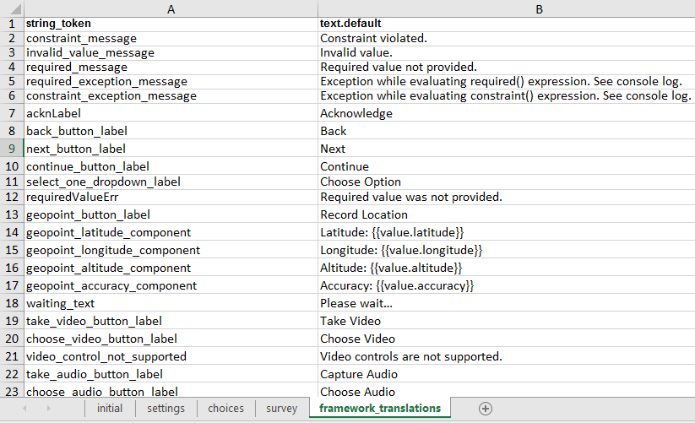
framework_translations
Add a tab: framework_translations
This sheet allows you to customize the buttons and messages on the survey in English or another language.
Hint: There are so many rows, just copy these columns from the examples with app-designer, then customize.
Column headers are string_token, text.default
Will learn about translations to add other languages soon!
Example:

Slide 12
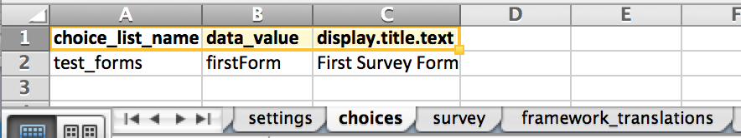
Creating the Framework, Cont. 2
Create the choices tab
Enter test_forms as choice_list_name, firstForm as data_value and First Survey Form as display.title.text
Create the survey tab. You will now add seven columns
branch_label
url
clause
condition
type
values_list
display.prompt.text

Slide 13
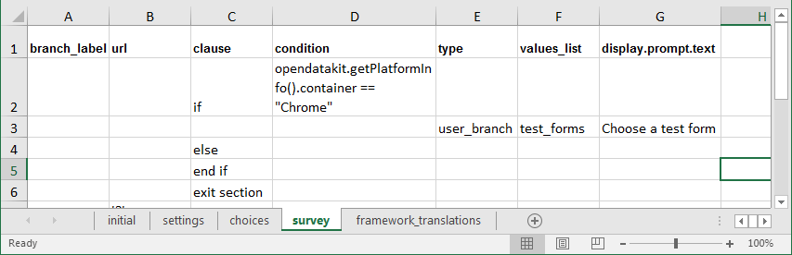
Clause & Condition for Chrome (Survey)
In C2 (clause) enter if
clause is how you do if statements
In D2 (condition) enter opendatakit.getPlatformInfo().container == "Chrome”
This tells the software what to do if you’re working in Chrome (previewing)
In E3 (type) enter user_branch
This says what part of the survey to branch to
In F3 (values_list) enter test_forms
Remember this is what we called the choice list
In G3 (display.prompt.text) enter Choose a test form

Slide 14
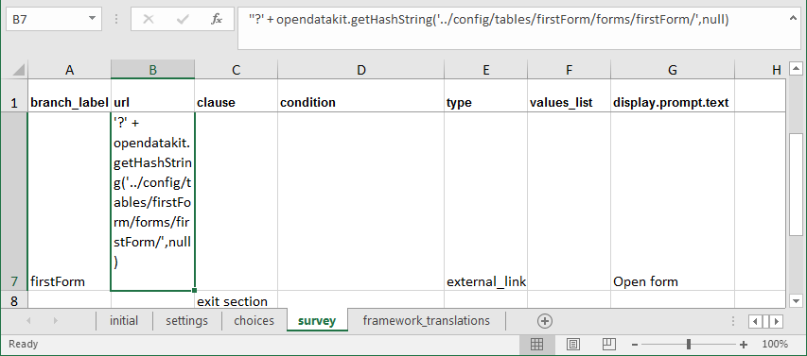
Clause & Condition for Tablet
In C4 (clause) enter else
This is the alternative when if is false
In E5 (type) enter note
In G5 (display.prompt.text) enter This is the default form.
In C6 (clause) enter end if
Ends the clause
In C7 (clause) enter exit section
In A8 (branch_label) enter firstForm
This is our form
In B9 (url) enter '?' + opendatakit.getHashString('../config/tables/firstForm/forms/firstForm/',null)
This links to the form
In E9 (type) enter external_link
Helps link to the form
In G9 (display.prompt.text) enter Open Form
In C10 (clause) enter exit section
Done!
Our framework is complete. Save it!

Slide 15
Using App-Designer & Grunt

Slide 16
Using App-Designer & Grunt
Now it’s time to go back to your command window and cd …/app-designer
Enter grunt
Should open Chrome and display the development environment
Tabs:
Preview (can “test” forms here)
Customize (add logo, change colors)
XLSX Converter (how our Excel will become a form)
File browser
Shows file structure within app-designer

Slide 17
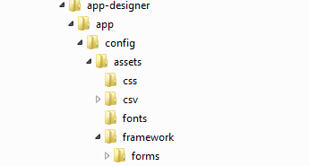
Converting framework
Need to convert the framework to update what surveys are available
Go to XLSX Converter tab
Drag and drop or choose file for framework.xlsx
Choose file and find your framework.xlsx

Slide 18
If all has gone well…
There should be data in the output section
to be saved as the common definitions, commonDefinitions.js, framework definitions, frameworkDefinitions.js, and form definition, formDef.json.
Then click Save to File System
You should get three messages in sequence about saving files to
commonDefinitions.js, frameworkDefinitions.js, formDef.json
Can see new files in file browser
If all has not gone well, hopefully the error message is helpful…

Slide 19
Converting the survey
Now choose file: firstForm in xlsxconverter
If all has gone well, will again get output
Click Save to File System
Should save
formDef.json
Definition.csv
Properties.csv
tableSpecificDefinitions.js
You can see these newly created files on the computer

Slide 20
Preview
Now click Preview
You should see First Survey Form
If not, try “purge database” in preview
Your framework hopefully shows your test form!

Slide 21
Check it out
Click on First Survey Form
You should then have the option to Open form by clicking Follow link
This should then take you to an ODK Survey simulator specific to our form, listing our form name: First Survey Form and version
Click “Create new instance” (this is how you do a new observation)
You’ll be told you’re at the start of a new instance, go to next prompt

Slide 22
Your question
You should see the question and choices you created. Now you can answer your question!
Click next
You finished filling out your first survey, congratulations
Now you can finalize the survey, which is how you distinguish a complete survey from an incomplete survey
You will get bounced back to where you can link to the survey again
Click the link again, and you can see now that you can create another new instance or work on a previously created instance

